Slide 1

PYTHON PROJECT
Presented by-
Ch. Sahasra (22H51A0411)
Ch. Snehitha (22H51A0412)
Ch. Sathwik (22H51A0413)
Ch. Varshini Reddy (22H51A0414)
Ch. Neethika Reddy (22H51A0415)

Slide 2
CONTENTS
FLOW CONTROL STATEMENT:
CONDITIONAL STATEMENTS
TRANSFER STATEMENTS
ITERATIVE STATEMENTS

Slide 3

CONDITIONAL STATEMENTS:
The if statement
The if-else statement
The nested-if statement
The if-elif-else ladder

Slide 4

THE IF STATEMENT:
The if statement is the most simple decision-making statement. It is used to decide whether a certain statement or block of statements will be executed or not.
SYNTAX:
if condition: statement1 statement2
EXAMPLE:
i = 10
if (i > 15):
print("10 is less than 15")
print("I am Not in if")

Slide 5
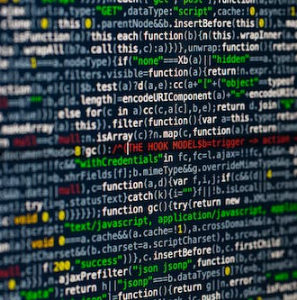
THE IF-ELSE STATEMENT:
The if statement alone tells us that if a condition is true it will execute a block of statements and if the condition is false it won’t.
Syntax of Python If-Else:
if (condition): # Executes this block if condition is true else: # Executes this block if condition is false
EXAMPLE:
i = 20
if (i < 15):
print("i is smaller than 15")
else:
print("i is greater than 15")

Slide 6
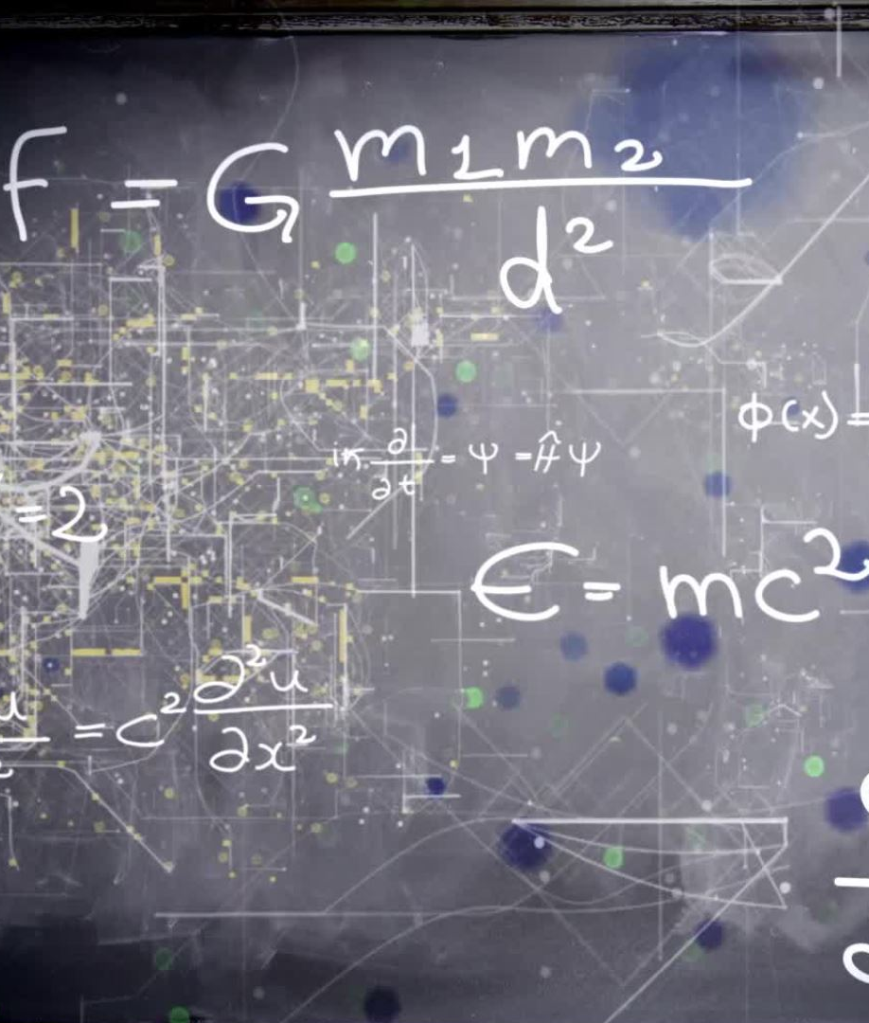
THE NESTED-IF STATEMENT:
Nested if statements mean an if statement inside another if statement.
Syntax:
if (condition1): if (condition2):
EXAMPLE:
i = 10
if (i == 10)
if (i < 15):
print("i is smaller than 15")
if (i < 12):
print("i is smaller than 12 too")
else:
print("i is greater than 15")

Slide 7

THE IF-ELIF-ELSE STATEMENT:
Here, a user can decide among multiple options. The if statements are executed from the top down.
SYNTAX:
if (condition): statement elif (condition): statement . . else: statement
EXAMPLE:
i = 10
if i < 15: print("i is less than 15")

Slide 8
CONDITIONAL STATEMENTS
…...…................ADVANTAGES......................
Decision-Making:
Conditional statements allow you to make decisions in your code.
Flexibility:
Conditional statements provide flexibility in handling different scenarios.
Control Flow:
Conditional statements control the flow of a program
….............DIS-ADVANTAGES......................
Code Duplication:
If not properly managed, conditional statements can lead to code duplication.
Nested Complexity:
Excessive nesting of conditional statements can lead to code complexity and decreased readability.
Maintainability:
As the number of conditions increases, maintaining and updating the code may become more challenging.

Slide 9
TRANSFER STATEMENTS:
Break Statement
01
Continue statement
02
Pass Statement
03

Slide 10

BREAK STATEMENT
In Python, break allows you to exit a loop when an external condition is met.
Syntax:
Loop{ Condition: break }
PROGRAM:
for i in range(10):
print(i)
if i == 2:
break

Slide 11

CONTINUE STATEMENT:
We can use continue statement to skip current iteration and continue next iteration
Syntax
while True: ... if x == 10: continue print(x)
EXAMPLE:
for var in "Python Poject":
if var == "e":
continue
print(var)

Slide 12

PASS STATEMENT:
When the user does not know what code to write, So user simply places a pass at that line.
SYNTAX:
def function():
pass
EXAMPLE:
n = 10
for i in range(n):
# pass can be used as placeholder
# when code is to added later
pass

Slide 13
TRANSFER STATEMENT
ADVANTAGES
DIS-ADVANTAGES
Early Exit from Loop:
break is used to exit a loop prematurely when a certain condition is met.
Skip Iteration:
continue is used to skip the rest of the code inside a loop for the current iteration and move to the next iteration.
Placeholder for Future Code:
pass is used as a placeholder when syntactically some code is required but no action is desired.
Potential for Unread Code:
Misuse of break can lead to unreadable code.
Risk of Placeholder Overuse:
Overusing pass might indicate incomplete implementation or missed requirements.

Slide 14

ITERATIVE STATEMENT:
An Iterative statement allows us to execute a statement or group of statement multiple times. Repeated execution of a set of statements is called iteration or looping.
Types of Iterative Statement:
1. while loop
2. for loop
3. Nested loop

Slide 15
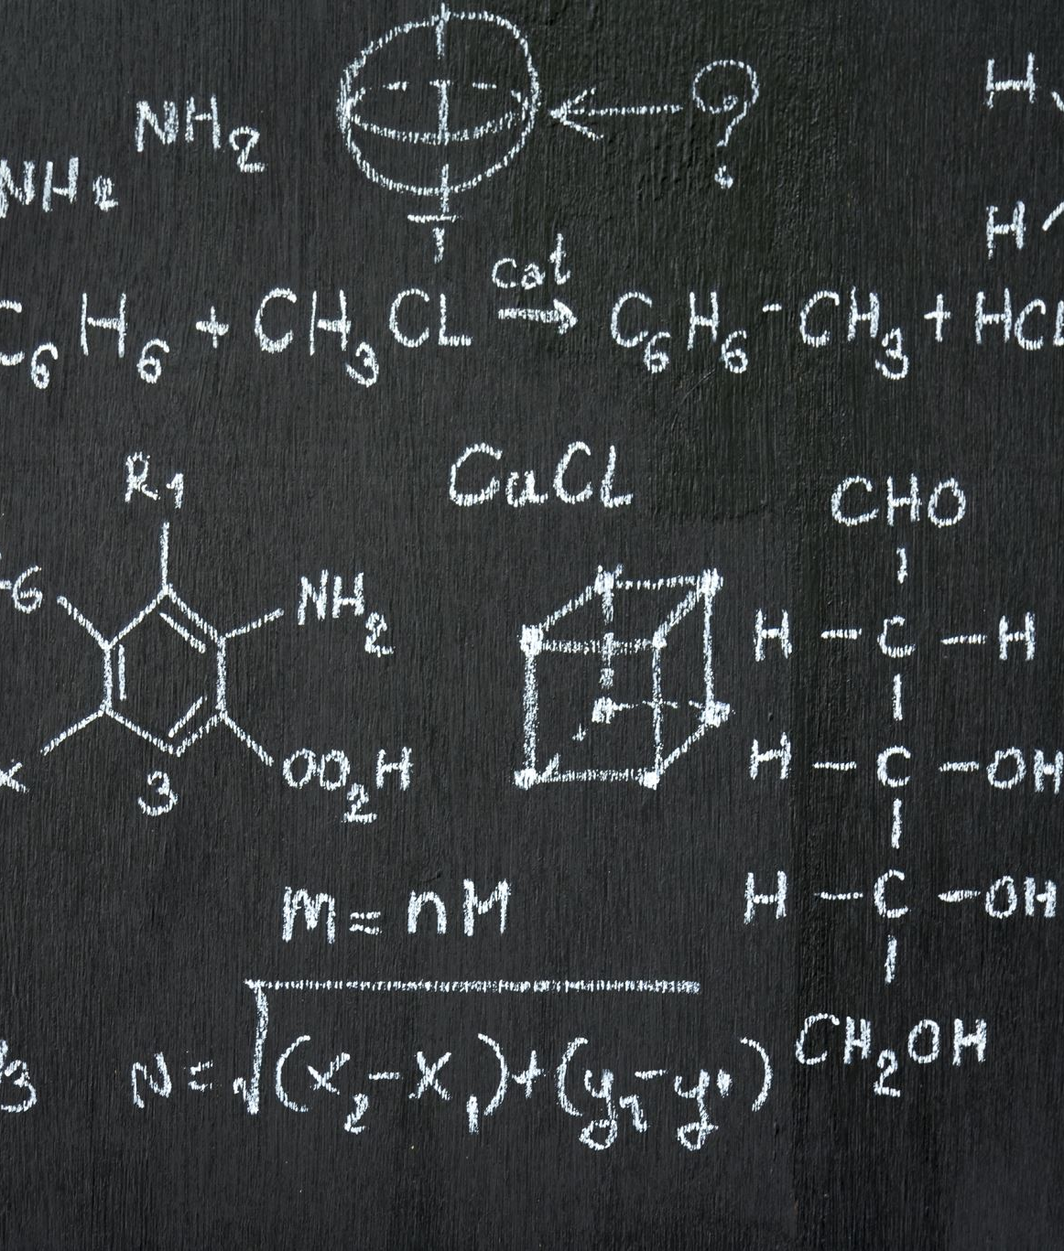
WHILE LOOP
A while loop executes a block of statements again and again until the condition gets false. The while keyword is followed by test expression and a colon.
SYNTAX:
while expression:
true statements
EXAMPLE:
n=int(input("Enter the number:"))
i=1
fact=1
while(i<=n):
fact=fact*i
i=i+1
print("The factorial is",fact)

Slide 16
FOR LOOP:
The for loop is used in the case where we need to execute some part of the code until the given condition is satisfied.
SYNTAX:
for iterating_var in sequence:
statement(s)
EXAMPLE:
for letter in'python':
print('The current letter:', letter)

Slide 17
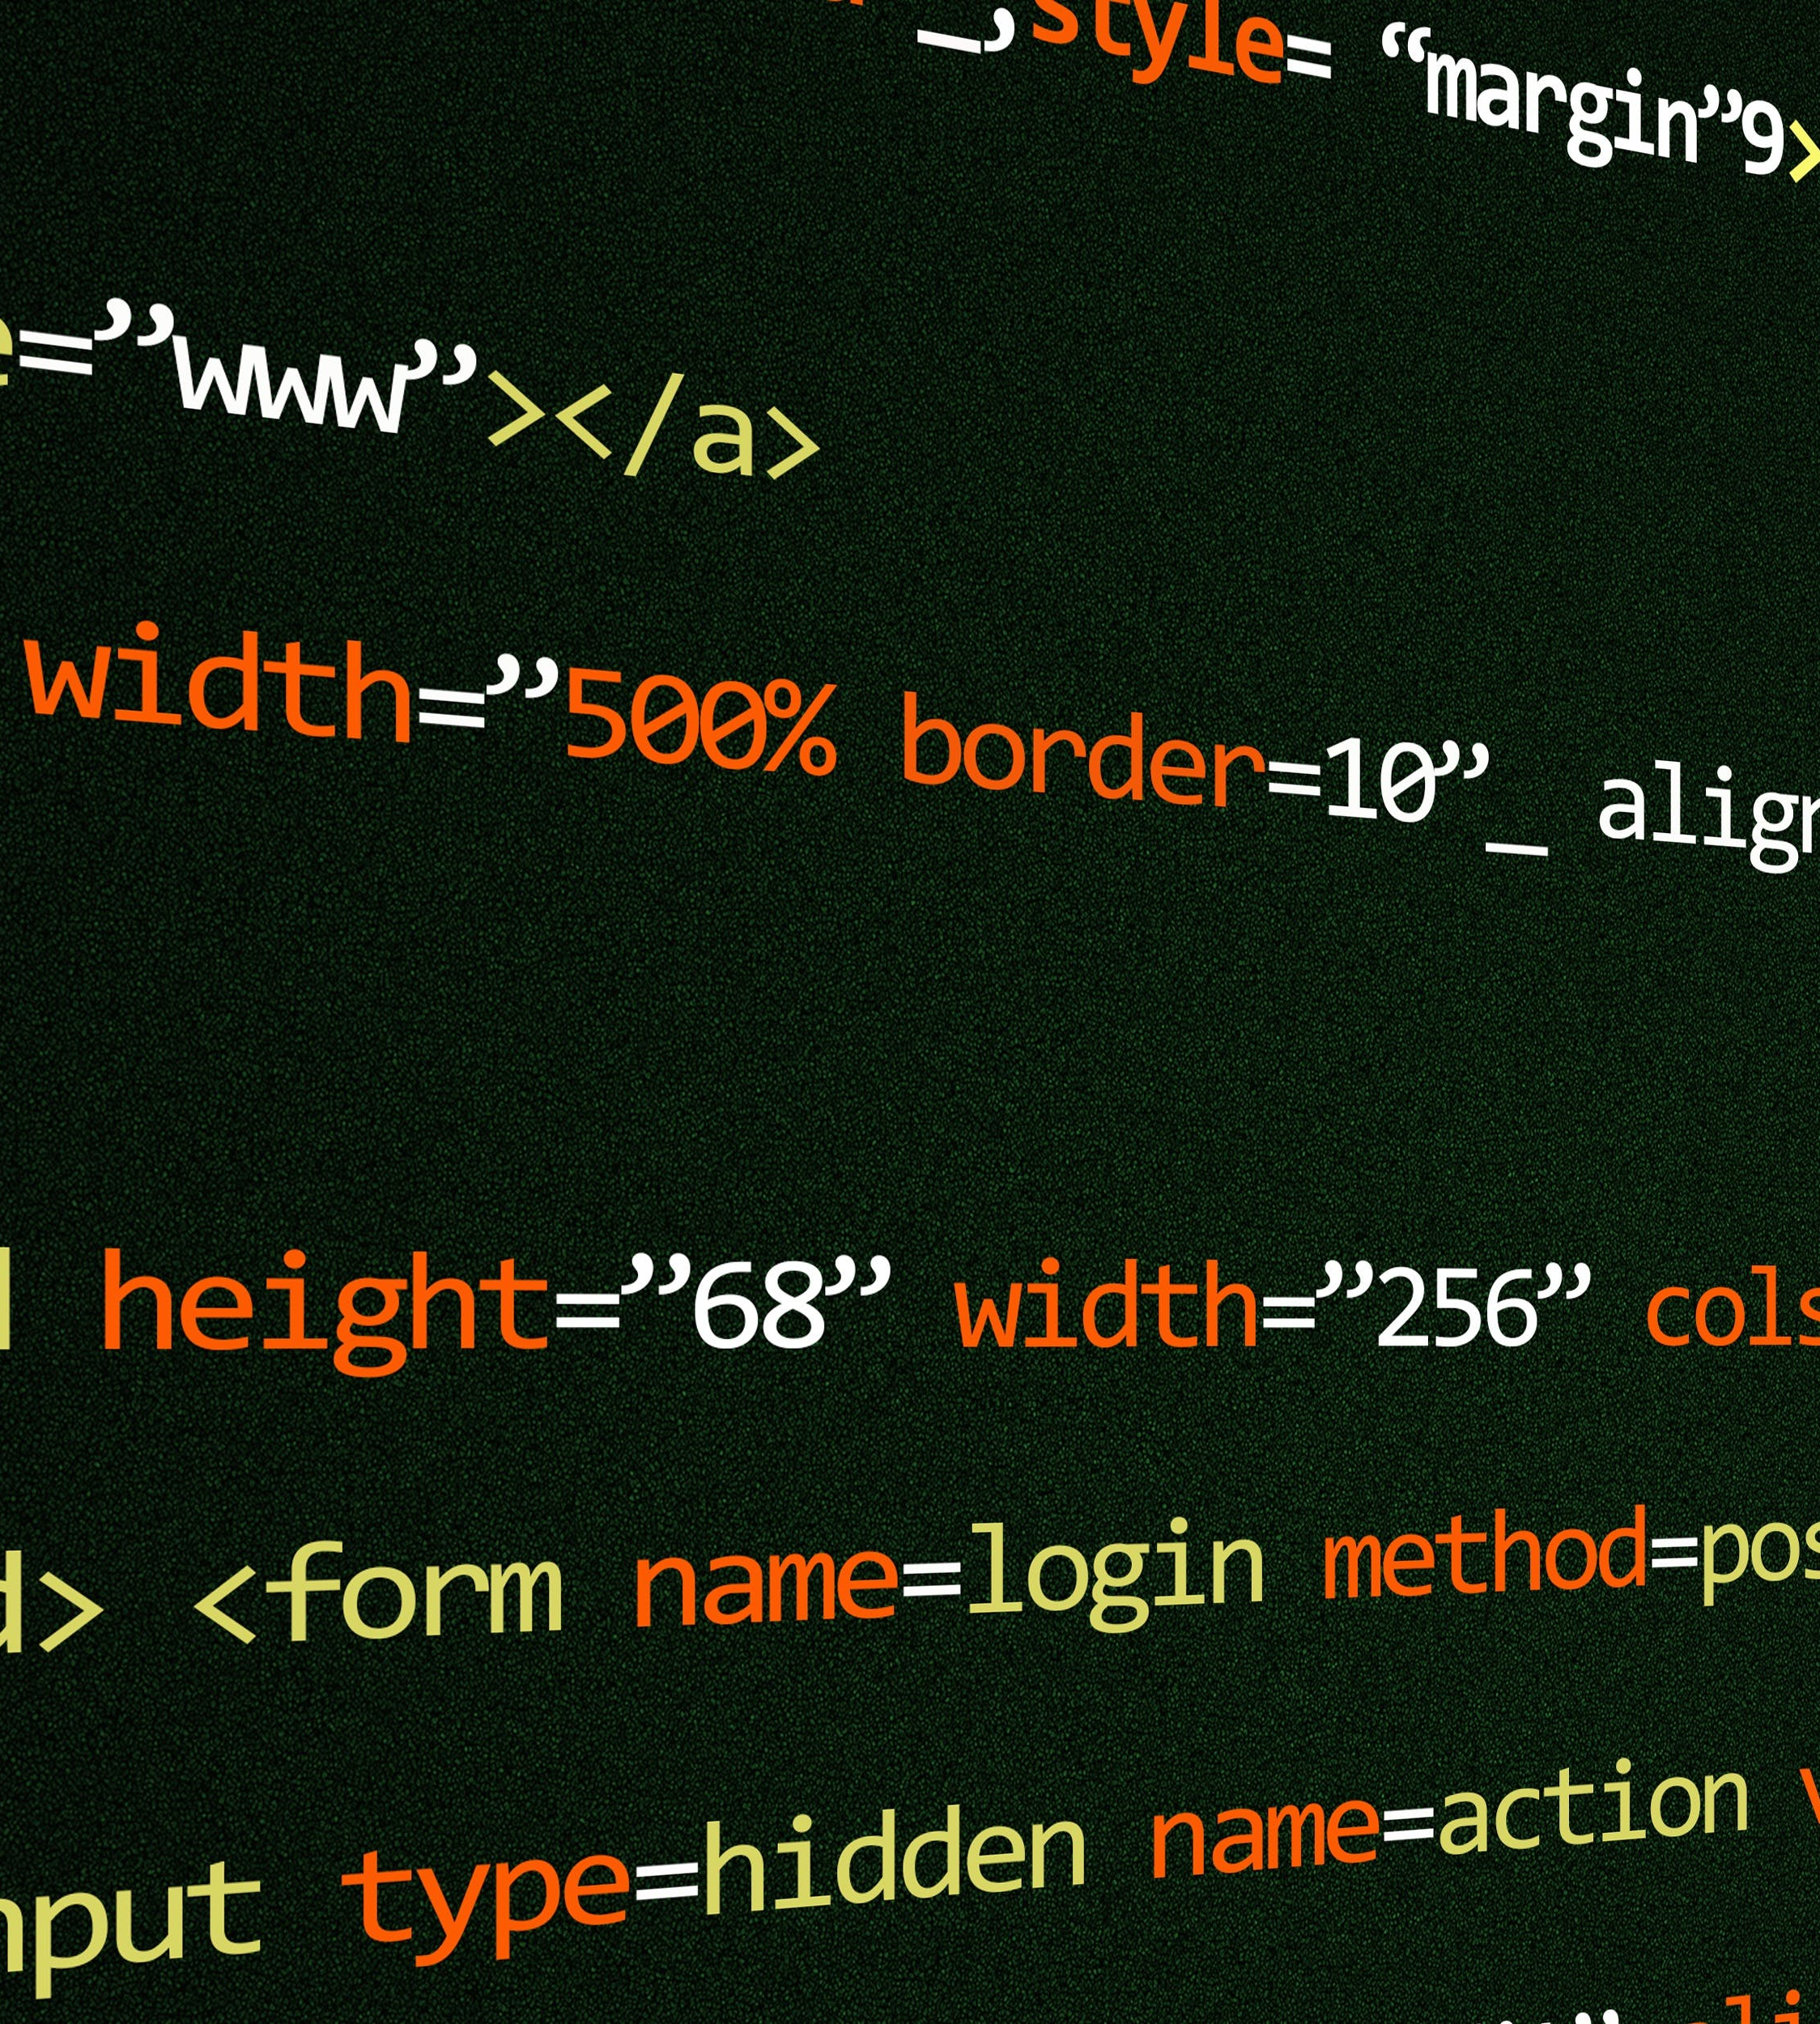
DO-WHILE LOOP:
The do-while loop continues until a given condition satisfies. It is also called post tested loop. It is used when it is necessary to execute the loop at least once (mostly menu driven programs).
SYNTAX:
do {
//statement
} while (condition);
EAXMPLE:
i = 1
while True:
print(i)
i = i + 1
if(i > 5):
break

Slide 18
ITERATIVE STATEMENT
ADVANTAGES
DIS-ADVANTAGES
Dynamic Conditions:
while loops are useful when the number of iterations is not known beforehand and depends on a certain condition.
Automatic Iteration:
for loops automatically iterate over the elements of a sequence (e.g., a list), which simplifies code and reduces the chance of errors.
Potential for Infinite Loops:
fIf the loop condition is not properly managed, there is a risk of creating an infinite loop, leading to performance issues or program crashes.
Fixed Iteration:
for loops are less flexible when the number of iterations is not known beforehand or depends on a dynamic condition.

Slide 19

CONCLUSION:
Flow control statements are essential components of programming languages, allowing developers to manage the execution flow of a program.
In Python, these statements can be broadly categorized into conditional statements, transfer statements, and iterative statements.

Slide 20

THE END....

